Slide 1
GAIT ANALYSIS

Slide 2
INTRODUCTION
GAIT ANALYSIS IS A WIDELY USED TECHNIQUE IN MANY SYSTEMS INCLUDING SECURITY, DIAGNOSIS, COACHING, THERAPY & MOTION PREDICTION SYSTEM.
THE AIM OF THIS PROJECT IS TO USE GAIT FOR DIFFERENT PURPOSES OF NEED & PURSUE THE MAXIMUM EFFICIENT SYSTEM.

Slide 3
GAIT ANALYSIS
VIA
HISTOGRAM ANALYSIS TECHNIQUE
SIMPLE BUT EFFICIENT FOR IDENTIFICATION
AVERAGE GAIT CYCLE TECHNIQUE
EFFICIENT FEATURE MATCHING USING DTW ALGORITHM FOR IDENTIFICATION

Slide 4
HISTOGRAM ANALYSIS
DATA ACQUISITION
COMBINING DATA
MAKING A HISTOGRAM
NORMALISATION
CALCULATION OF SIMILARITY SCORE BETWEEN TEST DATA AND TEMPLATE DATA
RESULTS

Slide 5

DATA ACQUISITION & COMBINATION
SENSOR- ACCELEROMETER
SERIAL CHANNEL- WIFI
DATA LOGGING- SERIAL LOGGER
ORGANIZING FILES FOR INDIVIDUALS
DATA IS IN FORM OF X,Y,Z ACCELERATION SAMPLES (30 SAMPLES/S)
RAW DATA IS COMBINED VIA THE FORMULA

Slide 6
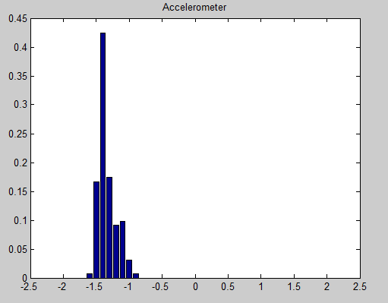
MAKING A NORMALISED HISTOGRAM
USING DATA LOG

Slide 7
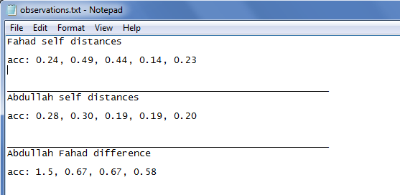
SIMILARITY SCORE
CALCULATION OF DIFFERENCE BETWEEN TWO HISTOGRAMS I.E TEST & TEMPLATE.
RESULTS

Slide 8
RESULTS & CONCLUSIONS
MINIMUM DIFFERENCE- PERSON IDENTIFIED
ERROR RATE – 5 %
SUITABLE FOR IDENTIFICATION AND NOT AUTHENTIFICATION
SIMPLE BUT EFFICIENT WITH ENOUGH DATA LOG

Slide 9
AVERAGE GAIT CYCLE
DATA ACQUISITION
NOISE FILTERING
NORMALIZATION
GAIT CYCLE PARTITION
CALCULATION OF AGC
FEATURES MATCHING
RESULTS

Slide 10
DATA ACQUISITION & FILTERING
SENSOR- ACCELEROMETER
SERIAL CHANNEL- WIFI
DATA LOGGING- SERIAL LOGGER
ORGANIZING FILES FOR INDIVIDUALS
DATA IS IN FORM OF Z ACCELERATION SAMPLES ONLY (30 SAMPLES/S)
FILTRATION THROUGH REMOVAL OF HIGH FREQUENCIES

Slide 11
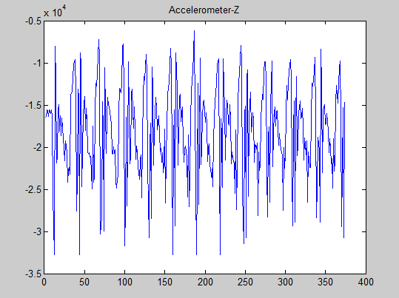
IMAGES

Slide 12
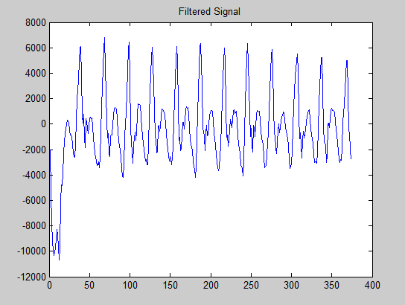
IMAGES

Slide 13


GAIT CYCLE PARTITION
IDENTIFICATION OF PEAKS ON Z- READINGS
DISTINCTION OF GAIT PEAKS USING FORMULA & IDENTIFICATION OF GAIT CYCLES USING GAIT PEAKS

Slide 14
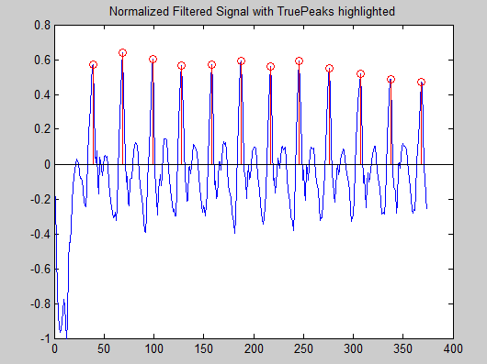
NORMALIZED SIGNAL WITH PEAKS

Slide 15
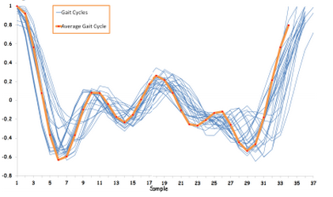
CALCULATION OF AGC
A CYCLE IS CALLED AN AVERAGE GAIT CYCLE IF IT IS THE MOST SIMILAR TO OTHER GAIT CYCLES

Slide 16
CALCULATION OF AGC
USING DYNAMIC TIME WARPING ON ALL GAIT CYCLES
DYNAMIC TIME WARPING (ALGORITHM)
DTW ALGORITHM AIMS AT ALIGNING TWO SEQUENCES OF FEATURE VECTORS BY WARPING THE TIME AXIS REPETITIVELY UNTIL AN OPTIMAL MATCH BETWEEEN THE TWO SEQUENCES IS FOUND
THIS ALGORITHM PERFORMS A PIECEWISE LINEAR MAPPING OF THE TIME AXIS TO ALIGN BOTH THE SIGNALS
HENCE CALCULATES THE DIFFERENCE BETWEEN RESPECTIVE INDEXES OF TWO GAIT CYCLES WITHOUT WORRYING ABOUT THEIR LENGTH FOR DIFFERENT USERS

Slide 17
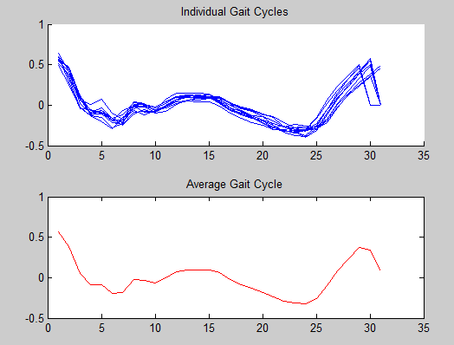
MINIMUM DISTANCES BETWEEN GAIT CYCLES DETERMINES THE AGC

Slide 18
FEATURES MATCHING
DIFFERENCE SCORE CALCULATION AMONG TEMPLATES AGC & TEST AGC USING DTW
MINIMAL SCORE DETERMINES THE MATCHING USER

Slide 19
RESULTS & CONCLUSIONS
ACCURACY RATE- 80%
EFFICIENT USING EXTRA SENSORS
LIMITED FEATURE EXTRACTION USING SINGLE AXIS (Z)
EXCELLENT FEATURE MATCHING RESULTS USING DTW
BEST FOR INDIVIDUAL IDENTIFICATION

Slide 20
REPORT
TWO TECHNIQUES ANALYZED & USED FOR BIOMETRIC IDENTIFICATION VIA GAIT ANALYSIS
ISSUES FACED
INACCURATE DATA RESULTS DUE TO LACK OF SENSORS
LESS UNIQUE TEMPLATES FOR INDIVIDUALS DUE TO LACK OF ENOUGH DATA
SUGGESTIONS REQUIRED FOR FURTHUR RESEARCH

